Slide 1
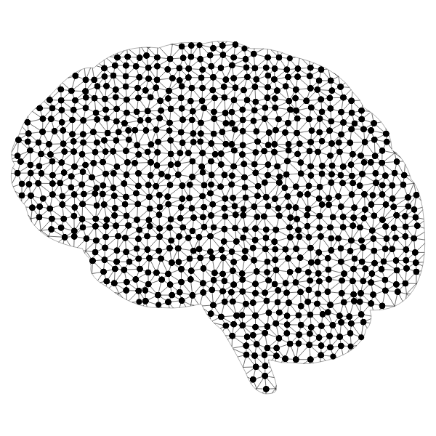

AI Section 6: Ethics in AI – Part II: Perspective and Diversity

Slide 2
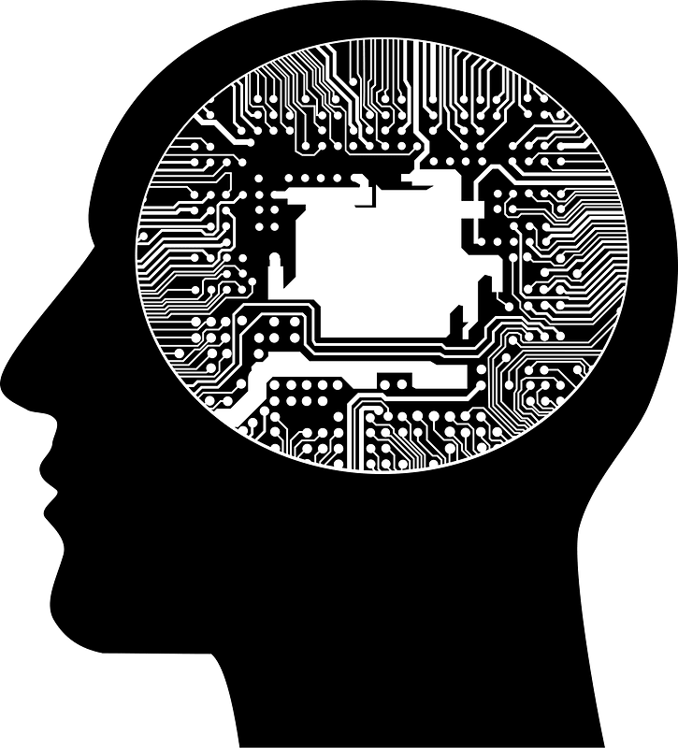
What are the Benefits of Diversity in AI?
Discuss and answer the following questions with those around you:
How do you think a rapidly changing field such as Artificial Intelligence can benefit from having a more diverse community of developers?
Why do you think having different perspectives is important when developing a product or working on a Team? How does diversity help achieve this?

Slide 3

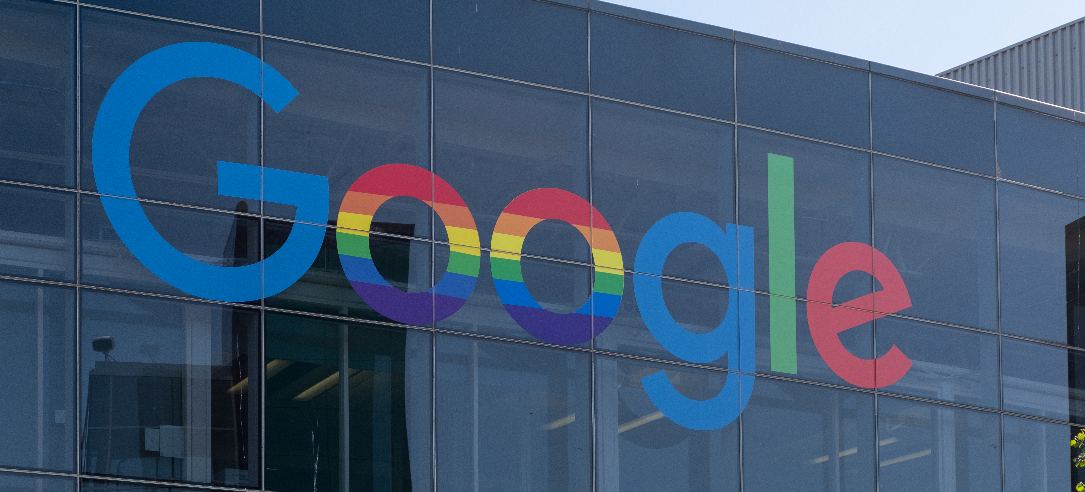
What is the “Diversity Crisis” in AI?
How does the current situation impact bias in Artificial Intelligence?
With men making up 80% of AI professions there is a very large disparity in representation of different identities and perspectives.
Only 10% of AI Researchers at Google and 15% of AI Researchers at Facebook are women.
African American individuals only make-up 2.5% of Google employees and 4% of employees at Facebook and Microsoft.
What aspects of AI is this likely to impact? How can bias be introduced through lack of representation?

Slide 4

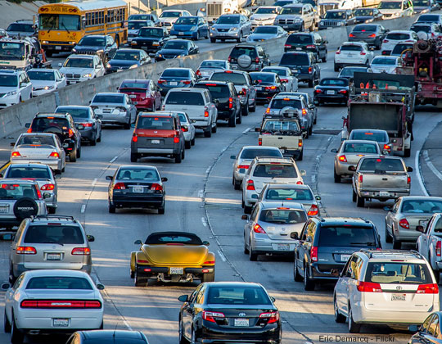
How is a Limited Perspective Harming AI?
How can a lack of diversity lead to increased bias in AI?
This lack of diversity directly effects the datasets that AI pulls from to make its predictions.
Applications such as image recognition suffer greatly from bias such as this, with less developed countries and underrepresented individuals being excluded from these data pools.
This can also effect applications such as self-driving cars where algorithms are trained on one country’s roads yet have no data from more rugged terrain or less maintained roadways.

Slide 5

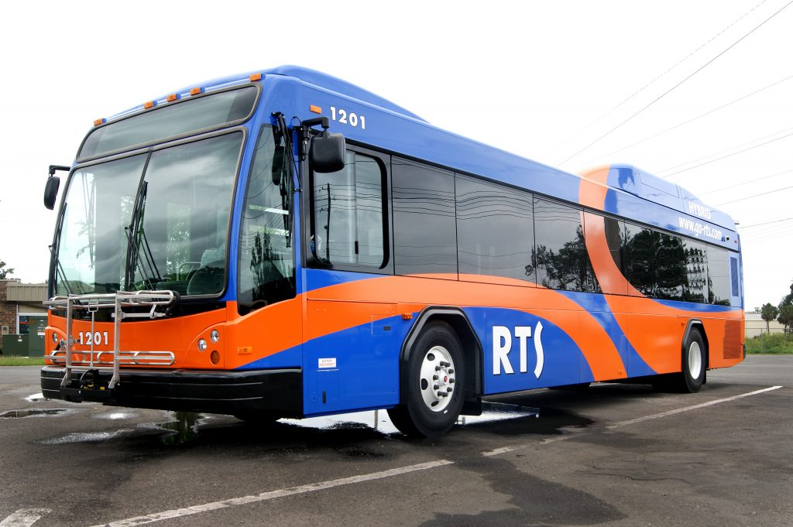
How is a Limited Perspective Harming AI?
This bias can be even more detrimental in fields such as healthcare where AI is being studied to assist in diagnosis.
However, countries and ethnicities with less representation will suffer greatly from inaccuracy if their data is not collected to be modeled/predicted from.
This can also greatly affect the outcomes of decisions in everyday lives if Artificial Intelligence is used to decide things such as loan acceptance or determine routes for public transportation.
Entire portions of the population could essentially be ignored by being absent from datasets.
How do you think we can enforce or establish regulations/principles to combat bias and uphold AI ethics in general?

Slide 6
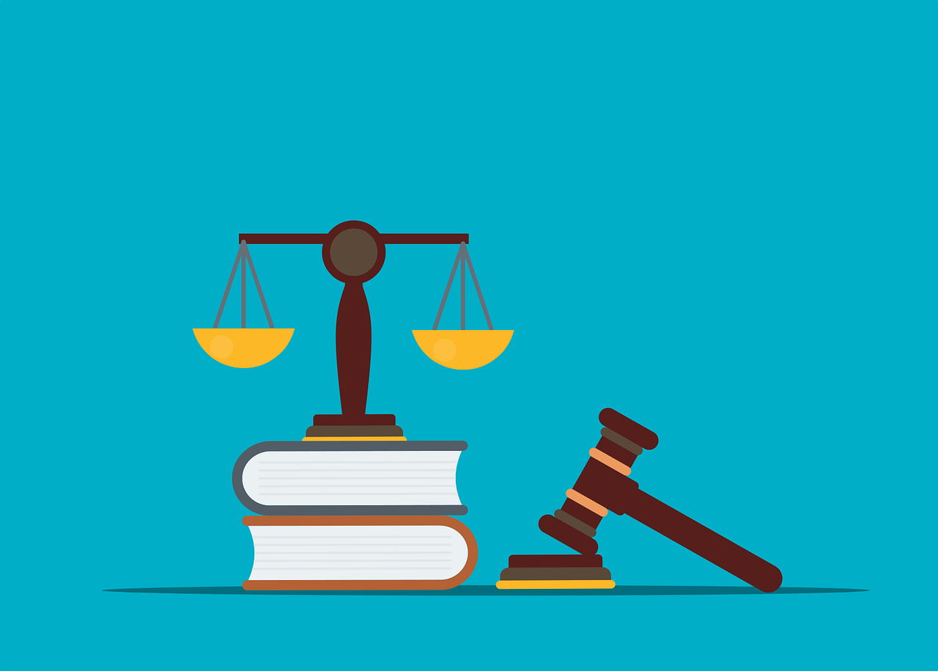
How do we Establish Ethics in AI?
First let’s consider 3 Basic Ethics Principles discussed by “The Belmont Report”.
Created in 1978 by the “National Commission for the Protection of Human Subjects of Biomedical and Behavioral Research”, The Belmont Report highlights three basic Ethics Principles that we will discuss in further detail:
1. Respect for Persons
2. Beneficence
3. Justice

Slide 7
3 Basic Ethics Principles
Benefits
Now we will take a closer look at these principles.
Respect for Persons
People should be treated as if they are capable of pursuing their own personal goals and able to act on their own.
Individuals who are impaired and as a result lack this capability should be protected or, at a minimum, made aware of any possible consequences.
Beneficence
People should not only be kept from harm, but there is an obligation that their “well-being” should be secured.
In general, no harm should be done to individuals and possible harm should be minimized while possible benefits should be maximized.
Harm

Slide 8
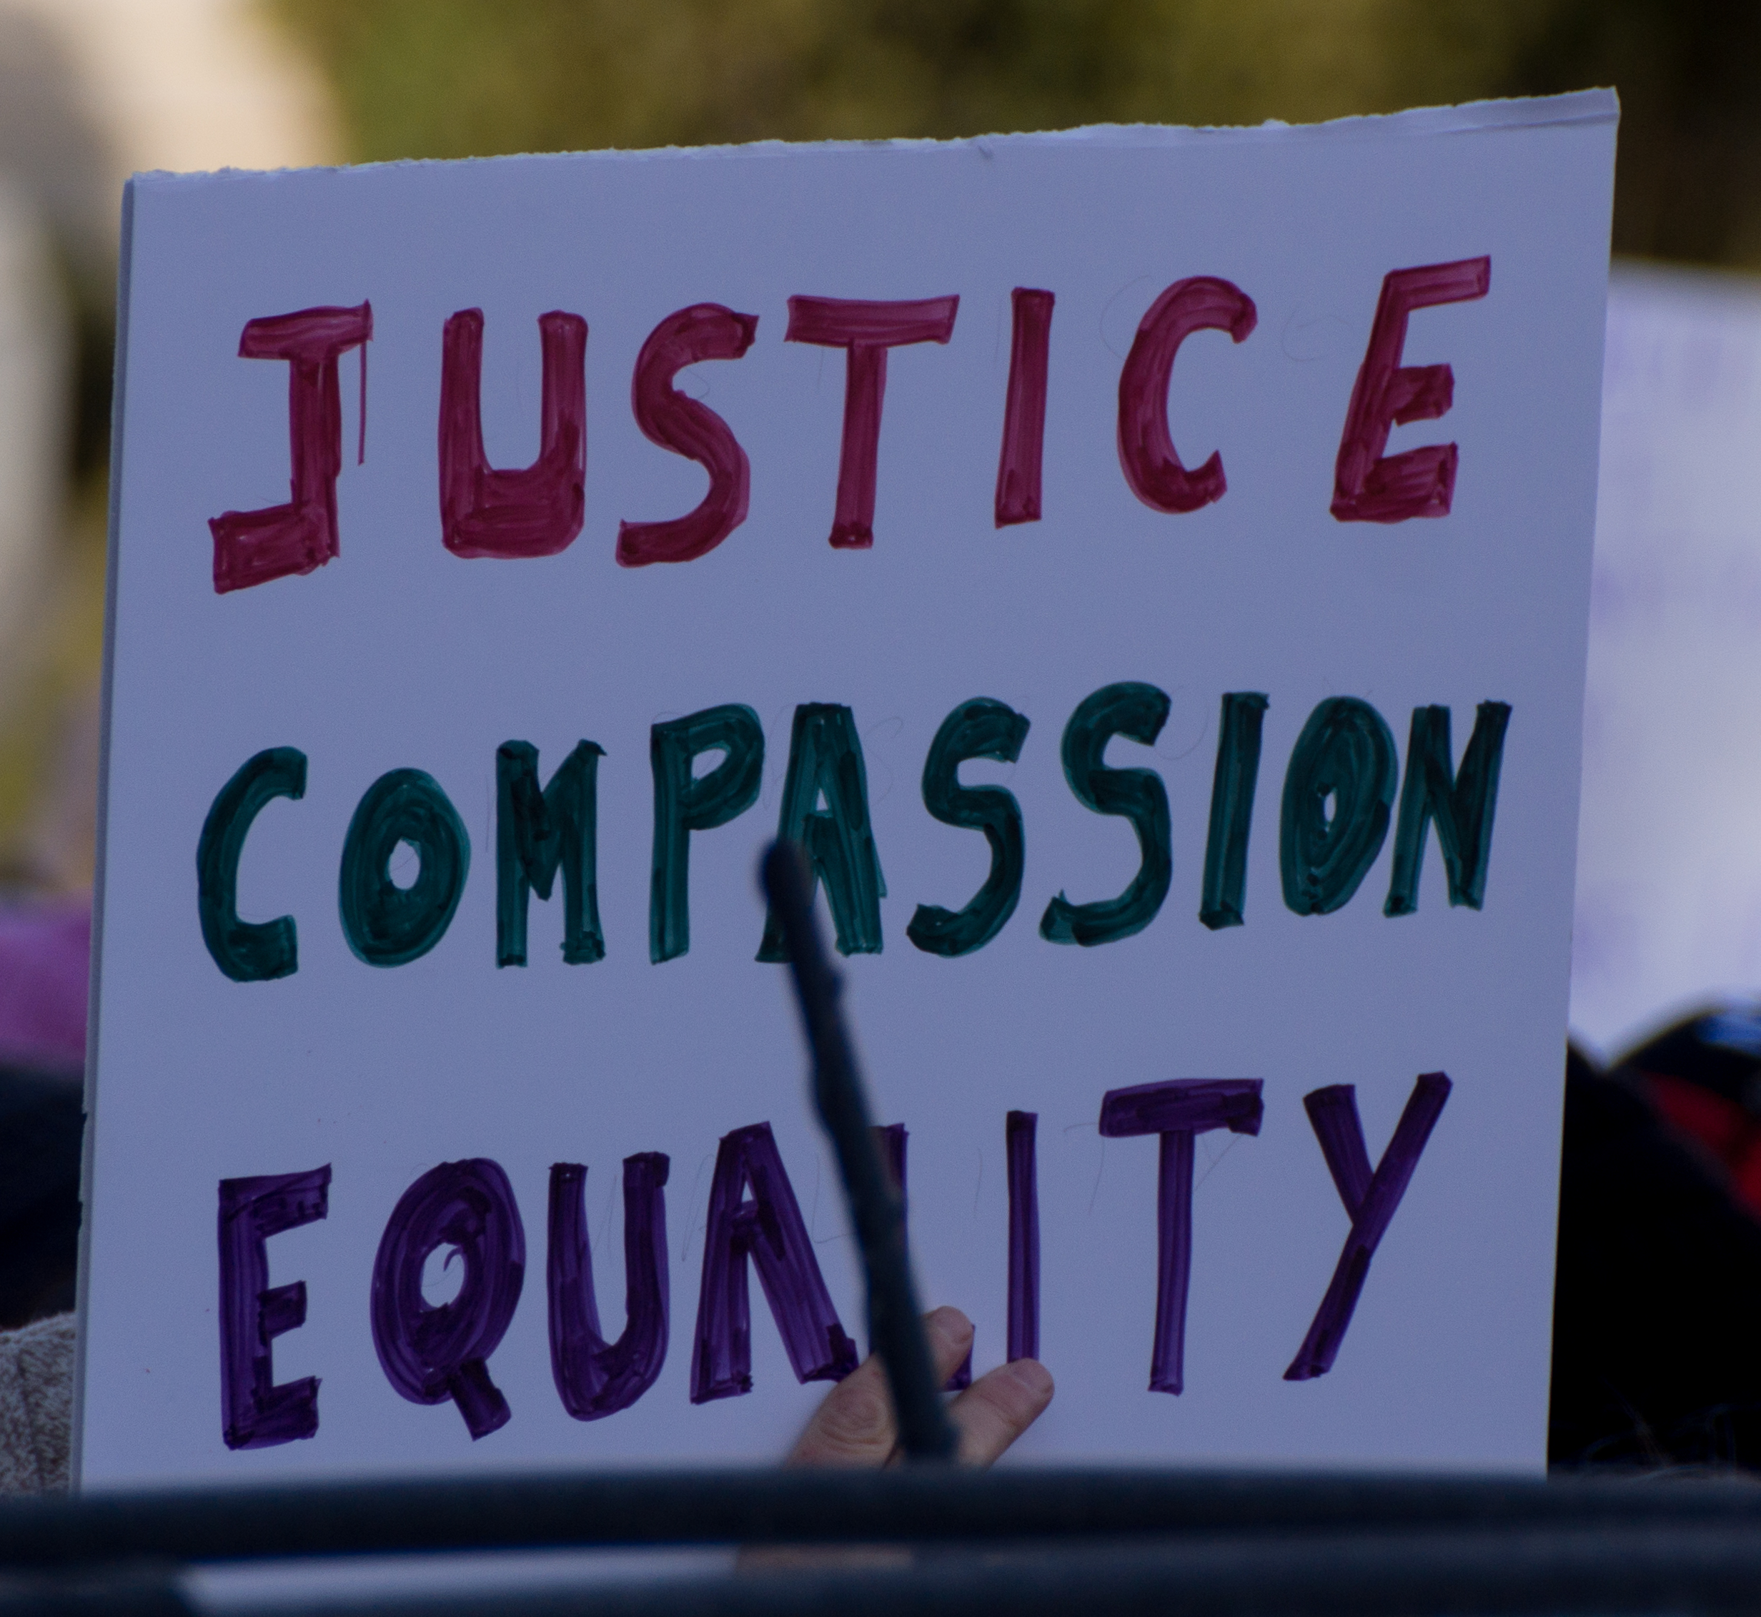
3 Basic Ethics Principles
Justice
Each person should possess an equal share of burdens and benefits.
Benefits and burdens should further be adjusted based on:
The need of the individual
The effort exerted by the individual
The societal contribution of the individual
The merit (goodness or excellence) of the individual
Do you agree with these basic principles? Is there anything you would get rid of or change?
How do you think these principles can be applied to ethics as it pertains to Artificial Intelligence?

Slide 9

Approaches for Establishing Ethics in AI
Results
Let’s look at how these principles are displayed in 2 approaches discussed by IBM.
Governance
This approach includes companies establishing their own quality assurance and standards concerning the collect of data and incorporating data ethics into those standards.
Teams like these can work towards ensuring basic ethical principles are upheld and lesser represented groups are adequately accounted for in data sets.
Explainability
As previously discussed in the “Principles of Trust in AI”, this revolves around the idea of transparency and avoiding “black box algorithms” that hide how their decisions are being made. This could allow the public to be reassured of equal representation in AI models.
Do you believe these approaches will be effective? What do you think is missing?
Unknown Process
Data

Slide 10
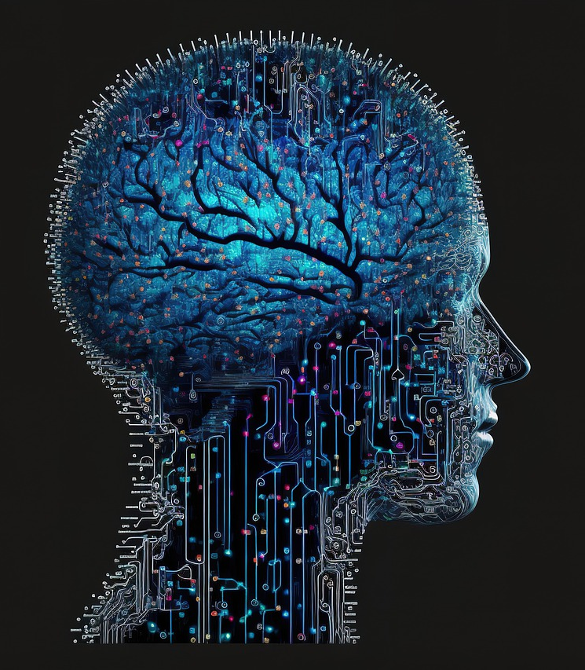
Understanding the Benefits of Diversity
How diversity can lead to innovation and unlikely new solutions
Now that we have looked at the principles of ethics and the hypothesized approaches of establishing ethics in AI, let’s return to the topic of “Diversity in AI”.
If we want to solve the “socio-technological” issue of ethics in AI (pertaining to both people and technology), we must foremost consider all people and look for a combination of ideas to create the most effective solution.
The idea that diversity directly results in innovation and unparalleled creativity is called “The Medici Effect”.
The different perspectives offered by a diverse group of individuals will most often provide solutions that would be impossible for a single perspective to create.

Slide 11
Understanding the Benefits of Diversity
Let’s emulate “The Medici Effect” by creating a story together!
In a group of at 3 to 4 members, individually create a set of 6 empty comic strip panels.
Do NOT communicate with your team members during this activity, as everyone possessing their own perspective and ideas is highly important.
Now, taking 45-60 seconds, create a drawing in your first panel of the comic, not including any words/dialogue.
Then, everyone in the group pass their comic strip clockwise and fill out the next panel of your group members comic, given another 45-60 seconds.
Repeat this process until everyone in the group has their story complete and return them to their original creator (the individual who drew the first panel).
Complete the first panel, then pass your comic!
Then take turns with a new member filling out each panel!

Slide 12
Reflecting on “The Medici Effect”
Discuss and answer the following questions with those around you:
How did the story you created with your group differ from the story you had imagined from the beginning? Do you think it is better or worse? Why?
Do you think you would have been able to come up with this exact story on your own?
How do you think “The Medici Effect” would play a role in the further development of AI, or any new technological advancement in general?

